Slide 1
Lecture 5
Speech Sounds
Terminology in this lecture is challenging!

Slide 2
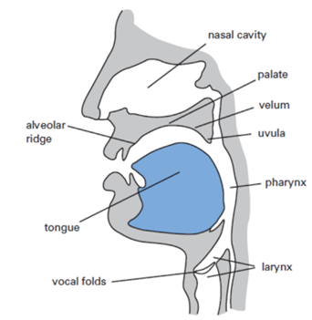
Phonetics and Phonology
Consonants
Vowels

Slide 3
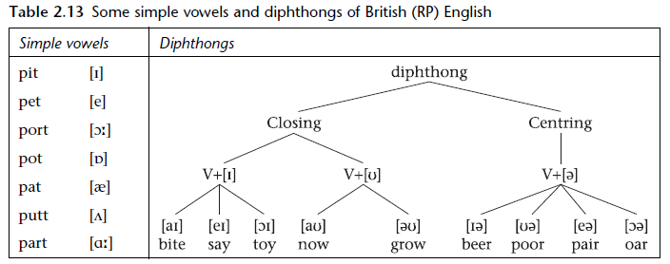


Vowels
Classification of vowels
Closing diphthongs?
Centering diphthongs?

Slide 4

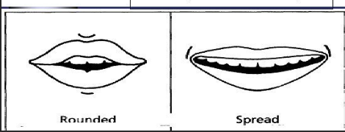
Ways to describe vowels
Place of articulation?
Manner of articulation?
State of vocal cords?
How to describe vowels?
position of the tongue
How high or low in the mouth is the tongue?
How forward or backward in the mouth is the tongue?
the shape of the lips
rounded or spread

Slide 5
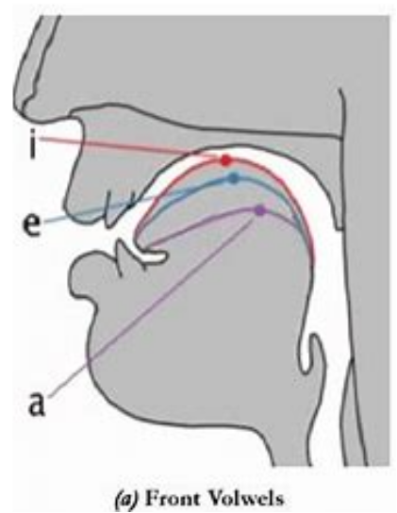
1. the position of the tongue
Horizontally, …
High vowels: (closed vowels)
- the tongue is positioned as close as possible to the roof of the mouth.
[i] [ɪ] [u] [ʊ]
Mid vowels:
- the tongue is positioned midway in your mouth.
[ɛ] [ə] [ʌ] [ɔ]
Low vowels: (open vowels)
- the tongue is positioned as far as possible from the roof of the mouth.
[a] [æ]

Slide 6
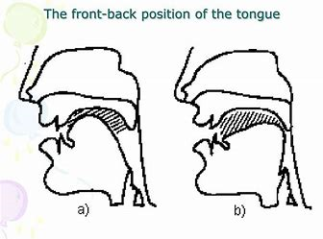
1. the position of the tongue
Vertically, …
Front vowels: (bright vowels)
- the tongue is positioned as far in front as possible in the mouth
[i] [ɪ] [ɛ] [æ]
Central vowels:
- the tongue is positioned halfway
[ə] [ʌ]
Back vowels (dark vowels)
- the tongue is positioned as far back as possible in the mouth.
[u] [ʊ] [ɔ] [a]

Slide 7
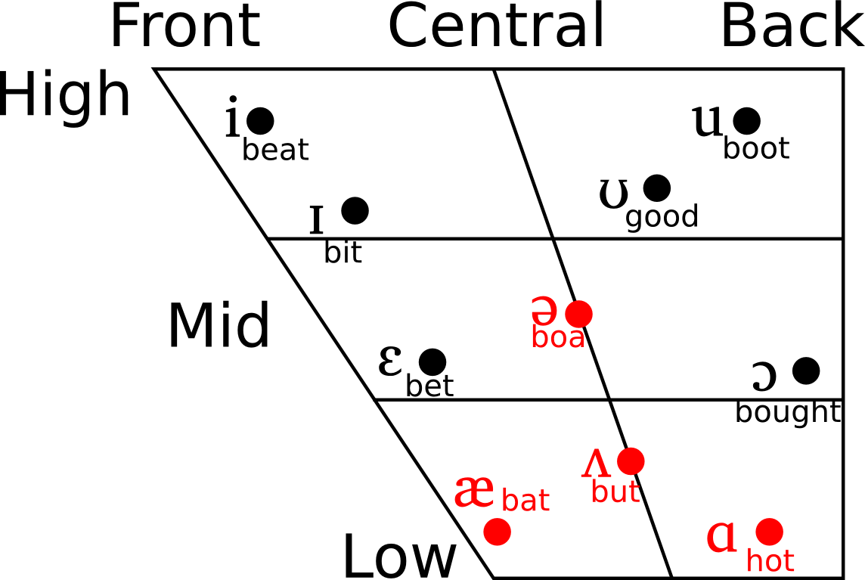

Slide 8
2. the shape of lips
– produced by rounding the lips
all the nonlow back vowels in English [u] [ʊ] [ɔ]
– produced not by rounding the lips
other vowels in English

Slide 9
Phonology
abstract or mental aspect of speech sounds
patterns of speech sounds

Slide 10


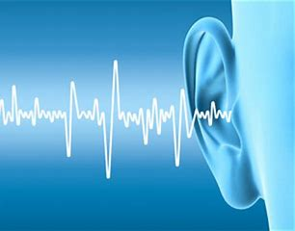
different people → same sound
the same way?
same person → same sound
different time
the same way?
which sounds are same?
which are not?

Slide 11
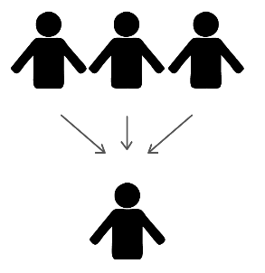


Slide 12
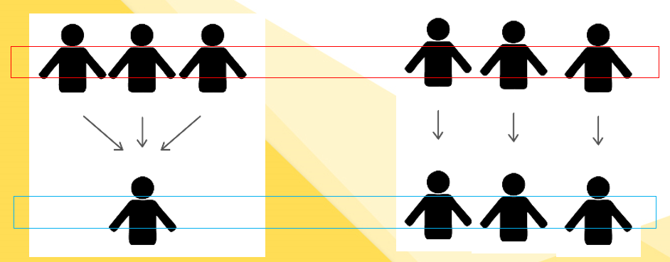
Phoneme vs Phone
actually articulated
an ABSTRACTION of a group of actually articulated sounds
spoken or heard
sensed in your mind
Not necessarily meaning distinguishing
meaning distinguishing
An individual sound
A sound type
Phonemes are conventionally placed between slashes (/ /) in transcription.
Phones/allophones are placed between square brackets ([ ]).

Slide 13
Phoneme and Allophone
a sound type
different versions of a phoneme
Phones of a same sound type
Examples?

Slide 14
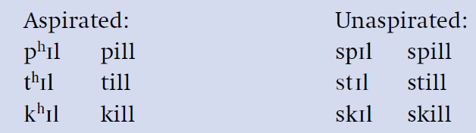

Examples of Allophones
Aspirated vs unaspirated sounds
Oral vowels vs nasal vowels

Slide 15

Determination of phonemes
Phonemes are established by the use of minimal pairs.
minimal pairs
pill/bill, tear/dear, pear/bear, bet/bat, site/side, kill/kiss, pat/bat
a minimal set.
feat/fit/fat/feat/fought/foot; big/pig/fig/dig/wig;
bill, dill, fill, gill, hill, jill, kill, lill, mill, nill, pill, sill, till, vill, will, yill, zill

Slide 16
Determination of phonemes
a total of 48 phonemes in one dialect of English.
Pure vowels: /iː/ /ɪ/ /e/ /æ/ /ʌ/ /ɜː/ /ə/ /uː/ /ʊ/ /ɔː/ /ɒ/ /ɑː/
Diphthongs: /eɪ/ /aɪ/ /ɔɪ/ /aʊ/ /əʊ/ /ɪə/ /eə/ /ʊə/
Consonants: /p/ /t/ /k/ /b/ /d/ /ɡ/ /f/ /s/ /ʃ/ /θ/ /h/ /v/ /z/ /ʒ/ /ð/ /tʃ/ /tr/ /ts/ /dʒ/ /dr/ /dz/ /m/ /n/ /ŋ/ /l/ /r/ /j/ /w/

Slide 17

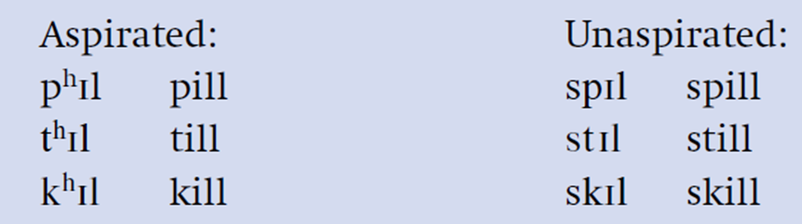
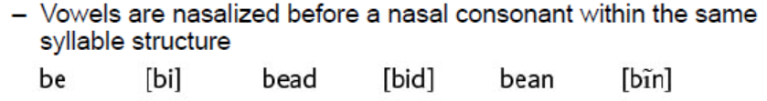
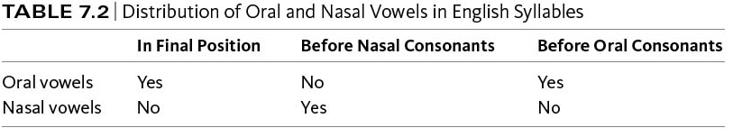
complementary distribution
Allophones of a phoneme are in complementary distribution.

Slide 18
Natural classes
A phoneme can have a lot of features.
A natural class contains all (and only) the sounds that share a particular set of features.
/p t k/ constitute the natural class of “voiceless stops” in English
/p t k b d g/. This is the natural class of stops.
/p t k b d/ do not constitute a natural class.

Slide 19

Natural classes
Identify whether the following phonemes are a natural set. If yes, specify the set of features they share.
/p t k m n ŋ/ *
/p b m/
/ /
/ /

Slide 20
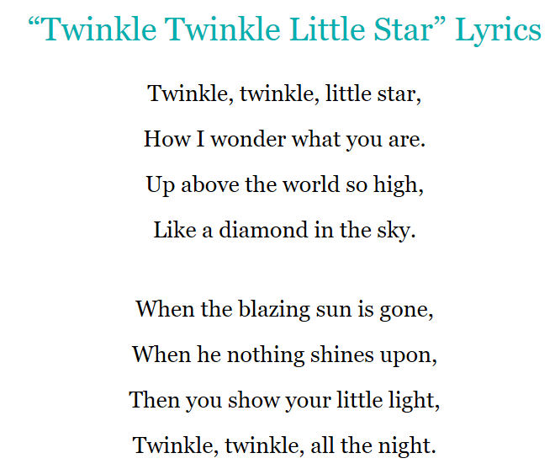
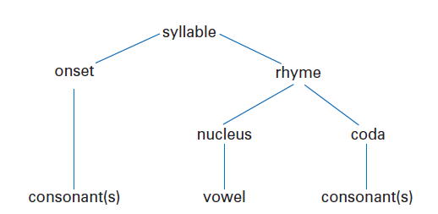
Syllable
Phoneme：an indivisible unit of sound
Syllable：a phonological unit composed of one or more phonemes.
Structure of a syllable (e.g., splint)
/m/, /n/, /l/ rhy-thm, bo-ttle
are, splint, post, buy, extreme, apple

Slide 21
Phonotactics
Phonemes are not combined randomly, but in a systematic and predictable way.
Some phoneme sequence is acceptable while others are unacceptable.
/tl/ does not occur at the beginning of a syllable in English.
train, plane, tlane*
atlantic, little

Slide 22
Phonotactic/phonological rules
- rules of sound distribution
- rules of sound combinations

Slide 23
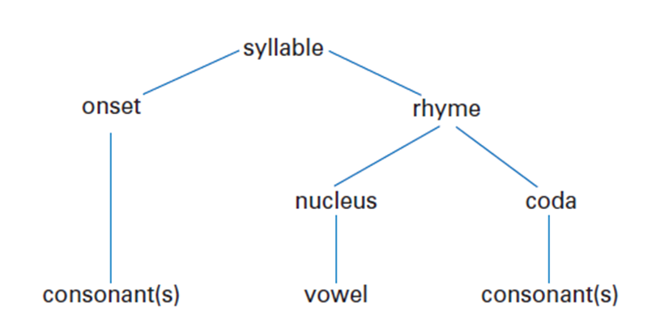
rules of sound distribution
It describes in which position of a syllable phonemes can occur.
Generally a long vowel or a diphthong can appear in an English syllable without onset and coda.
are, O'hara, Africa, Asia, auto, agriculture, author, …
But, a (a boy; she got a car), America, ability??
Iŋ/ never occurs in the onset of an English syllable.
IjI, Iwl and /h/ never occur in the coda position in English.

Slide 24
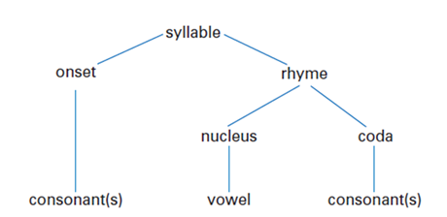
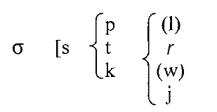
rules of sound combinations
In English onsets consisting of a three consonant cluster, the first phoneme is always a /s/, the second either /p/, /t/ or /k/ and the third /r/, /j/ or - in some cases - /l/ or /w/.
splay, spray, stray, squeal, scream, student, stew, *pstay, *wpjay

Slide 25
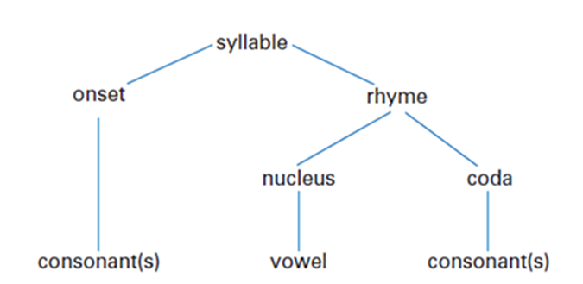
rules of sound combinations
Similarly, not all possible combinations of two consonants in the onset can occur in English. In general, two consonants that share a place of articulation cannot occur together.
*/tl/ and */dl/ (alverolars)
Plosives, fricatives and liquids cannot combine with nasals
*/bm/, */fn/, */ln/, */rm/

Slide 26
A phonological rule based on the following examples?
out, crowd, town, mouse, couch, south, rouse…
*aup, *auk, *aub, *awm, *aug, …

Slide 27
A phonological rule based on the following examples?
camp, hamper, bombard, paint, intelligent, wind, think, linguistics, sing, rang

Slide 28
A brief summary
Phonetics:
consonants
vowels
Phonology
Phoneme, phone, allophone
Syllable
Phonological/phonotactic rules

Slide 29
Reading materials for next week lecture
Chapter 5 Word formation
Chapter 6 Morphology

